Slide 1
Advanced Encryption Standards
(AES) Extensions
Siddhartha Valluri
Sri vivek Immadisetty

Slide 2
Agenda
About AES
AES encryption process
AES decryption process
Security
Performance

Slide 3
About AES:
AES is a secure block cipher of block length 128 bits.
It is secure, reliable and efficient.
Easy to implement
Best part of AES is it uses the same key for both encryption and decryption.
It has keys of sizes 128,192 and 256 bits to process the data blocks of 128 bits.
Encryption and decryption have 10/12/14 rounds for processing of 128/192/256 bits respectively.
The last round of encryption/decryption does not have the mixColumns()/InvmixColumns() step.

Slide 4
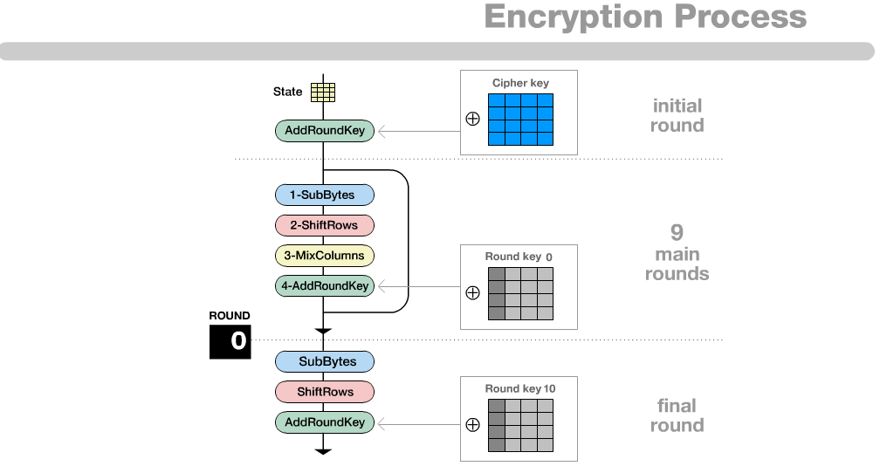
AES Encryption process:

Slide 5
Key Schedule/key expansion
We have to create round keys for each round, which is done using key-expansion process. If number of rounds is N_{r} , key-expansion creates N_{r}+1 128-bit round keys.
Key size(bytes) | Number of rounds (bytes) | Expanded Key (bytes)
4 | 10 | 44
6 | 12 | 52
8 | 14 | 60

Slide 6
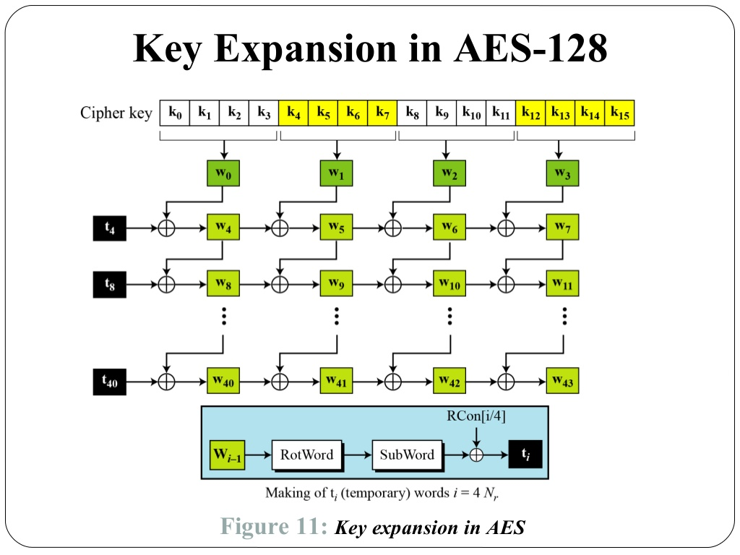
Key Expansion in AES-128:

Slide 7
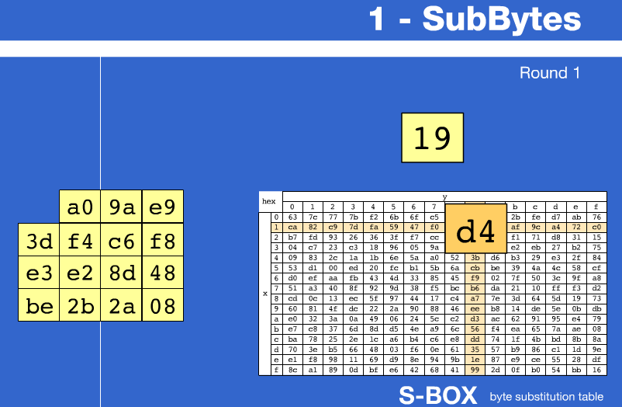
Steps involved in the encryption process
subBytes():
we use a lookup table of size 16*16 to replace the bytes indexed by the row.
The lookup table is called S-box.

Slide 8
shiftRows():
In this step, we just left shift elements in the rows of the matrix formed from the subBytes() process.
1st row: no change
2nd row: left shift by 1 byte
3rd row: left shift by 2 bytes
4th row: left shift by 3 bytes

Slide 9
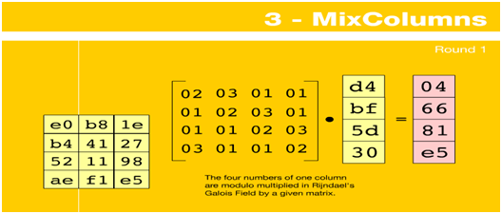
3. mixColumns():
The four columns are modulo multiplied in Galois Field(GF) by a given 4*4 matrix.

Slide 10
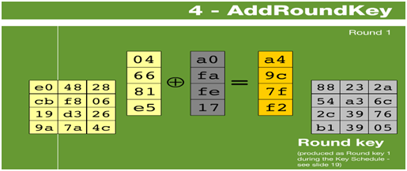
AddRoundKeys():
In this step, Round keys are used to generate a new matrix that is formed by XORing the state array with it.

Slide 11
AES decryption process:
This is similar to the encryption process, but does in reverse order.
inverse ShiftRows()
Inverse SubBytes()
AddRoundKey()
Inverse MixColumns()

Slide 12
Security:
AES was designed to face any kind of attack. Some of the attacks that have been tested:
AES is more secure because of its larger key size.
Of all attacks till date, known attacks were on 7/8/9 rounds for 128/192/256-bit keys respectively.
The key sizes in decimal terms are:
3.4 x 10³⁸ possible 128-bit keys,
6.2 x 10⁵⁷ possible 192-bit keys,
1.1 x 10⁷⁷ possible 256-bit keys,
And it is said that it takes 149 trillion years to break the 128-bit AES key.

Slide 13
Thank You.

